Slide 1


Spring Data Advanced Querying
Query Methods, JPQL Advanced Repositories, Spring Configuration
SoftUni Team
Technical Trainers
Software University
https://softuni.bg

Slide 2
Table of Contents
Retrieving Data by Custom Queries
Java Persistence Query Language
Repository Inheritance
Spring Custom Configuration

Slide 3
Questions
sli.do #Java-DB

Slide 4


Retrieving Data by Custom Queries
Querying

Slide 5
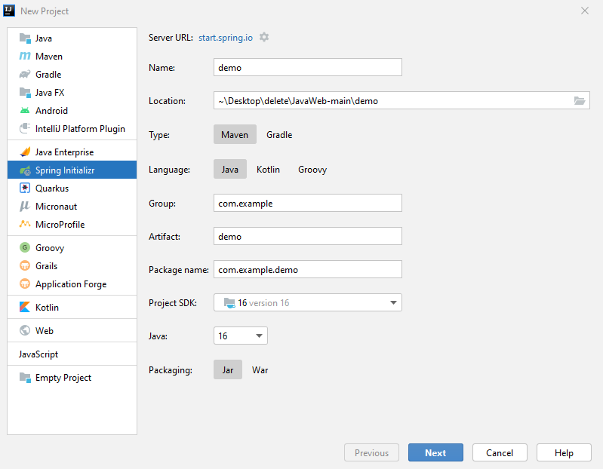
Spring Project (1)

Slide 6
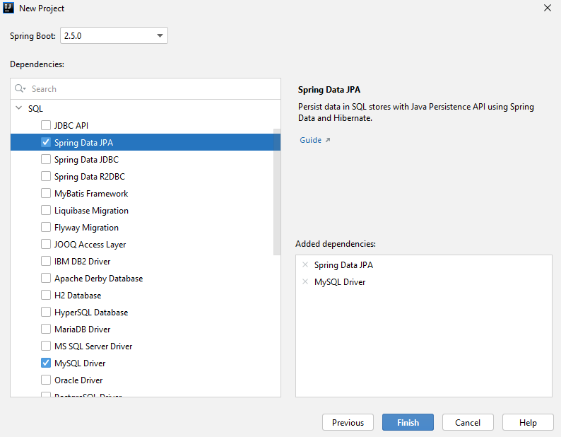
Spring Project (2)

Slide 7
application.properties – simple example
application.properties
#Data Source Properties
spring.datasource.driverClassName=com.mysql.cj.jdbc.Driver
spring.datasource.url=jdbc:mysql://localhost:3306/1working?useSSL=false&createDatabaseIfNotExist=true
spring.datasource.username=root
spring.datasource.password=12345
#JPA Properties
spring.jpa.properties.hibernate.dialect = org.hibernate.dialect.MySQL8Dialect
spring.jpa.properties.hibernate.format_sql = TRUE
spring.jpa.hibernate.ddl-auto = update
spring.jpa.open-in-view=false
###Logging Levels
# Disable the default loggers
logging.level.org = WARN
logging.level.blog = WARN
#Show SQL executed with parameter bindings
logging.level.org.hibernate.SQL = DEBUG
logging.level.org.hibernate.type.descriptor = TRACE

Slide 8
Query Methods
ShampooRepository.java
@Repository
public interface ShampooDao extends JpaRepository <Shampoo, Long> {
List<Shampoo> findByBrand(String brand);
}
Paramater
Query method
SQL
SELECT *
FROM shampoos AS s
WHERE s.brand = ?
Paramater

Slide 9
Query Lookup
Query Prefix
Field
List<Shampoo> findByBrand(String brand);
Return Type
Query Prefix
Field
Field
List<Shampoo> findByBrandAndSize (String brand, Size size);
Predicate Keyword

Slide 10
Query Methods
ShampooRepository.java
@Repository
public interface ShampooRepository extends JpaRepository<Shampoo, Long> {
List<Shampoo> findByBrandAndSize(String brand, Size size);
}
Query method
Paramater
Paramater
SQL
SELECT *
FROM shampoos AS s
WHERE s.brand = ?
AND s.size = ?

Slide 11
Problem: Select Shampoos by Size
Write a method that selects all shampoos by input size
Order the result by shampoo id
Example input-output:
MEDIUM
Nature Moments Mediterranean Olive Oil & Aloe Vera MEDIUM 6.50lv.
Volume & Fullness Lavender MEDIUM 5.50lv.
Rose Shine & Hydration MEDIUM 6.50lv.
Color Protection & Radiance MEDIUM 6.75lv.
…

Slide 12
Solution: Select Shampoos by Size
ShampooRepository.java
@Repository
public interface ShampooRepository extends JpaRepository<Shampoo, Long> {
List<Shampoo> getAllBySizeOrderById(Size sizeValue);
}

Slide 13


Java Persistence Query Language
JPQL

Slide 14
JPQL
Object-oriented query language
Part of the Java Persistence API
Used to make queries against entities stored in a relational database
SQL syntax operating with entities, not tables in the data source

Slide 15
JPQL Functionalities
JPQL
SELECT
DELETE
UPDATE

Slide 16
JPQL Select Syntax
Entity Class
Field
"SELECT i FROM Ingredient AS i WHERE i.name IN :names"
Object
Alias
Parameter

Slide 17
JPQL Join Syntax
Object
"SELECT s
FROM Shampoo AS s
INNER JOIN s.batch AS b
WHERE b.batchDate < :batchDate"
Class
Join
Field
Paramater

Slide 18
JPQL Syntax
Update:
Delete:
"UPDATE Ingredient AS b
SET b.price = b.price*1.10
WHERE b.name IN :names"
Parameter
"DELETE FROM Ingredient AS b
WHERE b.name = :name"

Slide 19
Problem: Select Shampoos by Ingredients
Write a method that selects all shampoos with ingredients in the given list
Example input-output:
Berry
Mineral-Colagen
Color Protection & Radiance
Fresh it Up!
Nectar Nutrition
Superfruit Nutrition
Color Protection & Radiance
Nectar Nutrition
…

Slide 20
Solution: Select Shampoos by Ingredients
ShampooRepository.java
@Repository
public interface IngredientRepository extends JpaRepository<Ingredient, Long>{
@Query(value = "select s from Shampoo s " +
"join s.ingredients i where i in :ingredients")
List<Shampoo> findByIngredientsIn(@Param(value = "ingredients")
Set<Ingredient> ingredients);
}

Slide 21


Repository Inheritance
Advanced Repositories

Slide 22
Repository Inheritance
In bigger applications, we have similar entities, extending an abstract class
Their base attributes and actions, towards them, are the same regardless of their differences
We can set up a base repository to reduce query and code duplication
It can be inherited to clear up specifics

Slide 23
Example: Repository Inheritance (1)
IngredientRepository.java
Not a repository
@NoRepositoryBean
public interface IngredientRepository<T extends Ingredient> extends JpaRepository<T, Long>{
//…
}
ChemicalIngredientRepository.java
@Repository
public interface ChemicalIngredientRepository extends IngredientRepository <BasicChemicalIngredient> {
List<ChemicalIngredient> findByChemicalFormula(String chemicalFormula);
}

Slide 24
Example: Repository Inheritance (2)
CustomShampooRepository.java
public interface CustomShampooRepository {
void create(BasicShampoo basicShampoo);
}
CustomShampooRepositoryImpl.java
@Repository
public class CustomShampooDaoImpl implements CustomShampooRepository {
@PersistenceContext
private EntityManager entityManager;
@Transactional
public void create(BasicShampoo basicShampoo){
entityManager.persist(basicShampoo);
}
}
Inject
Entity Manager
Single Transaction

Slide 25

Spring Custom Configuration
Java-Based Setup

Slide 26
Application Properties
So far, we've configured our project with a spring properties file:
application.properties
#Data Source Properties
spring.datasource.driverClassName = com.mysql.jdbc.Driver
spring.datasource.url = jdbc:mysql://localhost:3306/shampoo_company?useSSL=false&createDatabaseIfNotExist=true
spring.datasource.username = root
spring.datasource.password = 1234
Connection properties

Slide 27
Java-Based Configuration (1)
Configuration
Class
JavaConfig.java
@Configuration
@EnableJpaRepositories(basePackages = "com.demo.dao")
@EnableTransactionManagement
@PropertySource(value = "application.properties" )
public class JavaConfig {
//Add configuration
}
Repositories
Directory
Property File

Slide 28
Java-Based Configuration (2)
JavaConfig.java
@Autowired
private Environment environment;
@Bean
public DataSource dataSource() {
DriverManagerDataSource driverManagerDataSource = new DriverManagerDataSource(); driverManagerDataSource.setDriverClassName(environment.getProperty("spring.datasource.driverClassName"));
driverManagerDataSource.setUrl(environment.getProperty("spring.datasource.url"));
driverManagerDataSource.setUsername(environment.getProperty("spring.datasource. username"));
driverManagerDataSource.setPassword(environment.getProperty("spring.datasource. password"));
return driverManagerDataSource;
}
Data Source Connection

Slide 29
Java-Based Configuration (3)
JavaConfig.java
@Bean
public EntityManagerFactory entityManagerFactory() {
HibernateJpaVendorAdapter vendorAdapter = new HibernateJpaVendorAdapter();
vendorAdapter.setDatabase(Database.MYSQL);
vendorAdapter.setGenerateDdl(true);
vendorAdapter.setShowSql(true);
LocalContainerEntityManagerFactoryBean factory = new LocalContainerEntityManagerFactoryBean();
factory.setJpaVendorAdapter(vendorAdapter);
factory.setPackagesToScan("com.demo.domain");
factory.setDataSource(dataSource());
Properties jpaProperties = new Properties();
jpaProperties.setProperty("hibernate.hbm2ddl.auto","validate");
jpaProperties.setProperty("hibernate.format_sql", "true");
factory.setJpaProperties(jpaProperties);
factory.afterPropertiesSet();
return factory.getObject();
}
JPA Configuration
Models Package

Slide 30
Java-Based Configuration (4)
Transaction Manager Configuration
JavaConfig.java
@Bean
public PlatformTransactionManager transactionManager() {
JpaTransactionManager txManager = new JpaTransactionManager();
txManager.setEntityManagerFactory(entityManagerFactory());
return txManager;
}

Slide 31

Summary
…
…
…
Spring Data translates methods to SQL Queries
We can write custom queries
JPQL syntax on entity classes
Repositories can be inherited
Reduces code duplication for inherited entities

Slide 32
Questions?
Notes:
32

Slide 33













SoftUni Diamond Partners

Slide 34


Educational Partners

Slide 35
Trainings @ Software University (SoftUni)
Software University – High-Quality Education, Profession and Job for Software Developers
softuni.bg, about.softuni.bg
Software University Foundation
softuni.foundation
Software University @ Facebook
facebook.com/SoftwareUniversity
Software University Forums
forum.softuni.bg
Notes:
35

Slide 36

License
This course (slides, examples, demos, exercises, homework, documents, videos and other assets) is copyrighted content
Unauthorized copy, reproduction or use is illegal
© SoftUni – https://about.softuni.bg/
© Software University – https://softuni.bg
Notes:
36

